Slide 1
Team Dev A
Nothing as of now

Slide 2
Food Delivery Service
Description: A solution to order your meals online
Key features:
authorized city resident can place the food order to the nearby restaurants.
delivery person can pick up the order upon the request of restaurant manager .
restaurant manager can manipulate the food menu of the restaurant and tag some offers and discounts.
Roles:
Customer
Restaurant manager
Delivery person
Solution Manager

Slide 3
Customer persona
Jake is a college student who wants to access nearby restaurants to place the food order any time restaurant is open and he want the billing process to be automatic through either his credit card or his app wallet. Jake wants his delivery as quickly as possible, and he also likes the discounts and free addons
Alice is working lady who wants the food delivery for lunch every week day without need for explicit ordering and also she want to schedule of preferred lunch for each day and also likes the dish recommendation

Slide 4
Restaurant manager persona
Rave is the restaurant manager who want to list his restaurant in the application and receive the food order by online and able to notify nearby delivery person to pick the order, and also be able to update the food menu easily and each update should reflect to customer with minimum latency, and also he want to add the discount to specific dish or when ordered as combo

Slide 5
Delivery person persona
Daniel is the delivery person who must be able to pick the order whenever any nearby restaurant manager wants him to, he also want the details of the pickup and exact delivery location and customer contact info, he also want to be able to pickup the multiple orders and like the recommendation system that recommends to pick the multiple orders for the single trip.

Slide 6
Solution manager persona
Sailely is the solution manager and she want the info about the total orders placed and customers rating and feed back and can be able use that info for key analytics and make the business decision

Slide 7
Stories
Place order
As a customer, I want to browse through nearby restaurants and place food order, so that I can get food to eat at comfort of my home/office/anyplace.
Manage restaurant
As a restaurant manager, I want to list my restaurant in the application and temporarily hire delivery person to delivery the food to my customers, so that my restaurant can get easy customers.
As a delivery person, I want to pickup the orders from the restaurants and deliver it, so that I can get the employment.

Slide 8
Stories
Analyze the business:
As a solution manager/solution analyst, I want the analytics of business, so that I can take required business decisions or changes.

Slide 9
Defining SLIs and SLOs
User Story | SLO | SLI
Place Order | Available 99% | Fraction of 200 vs 500 API Request about restaurant and food menu
Place Order | 95% of requests will complete in under 300 ms. | Time to last byte GET requests measured every 10 seconds aggregated per minute
Manage Restaurant | Changes I have made must reflect on front end within 20 seconds. | Time to access solution backend + Time to push the changes in backend to customer aggregated to the day
Analyze the business | 95% of queries will completer in under 10sec | Time to last byte GET requests measured every 60sec aggregated per 10 minutes

Slide 10
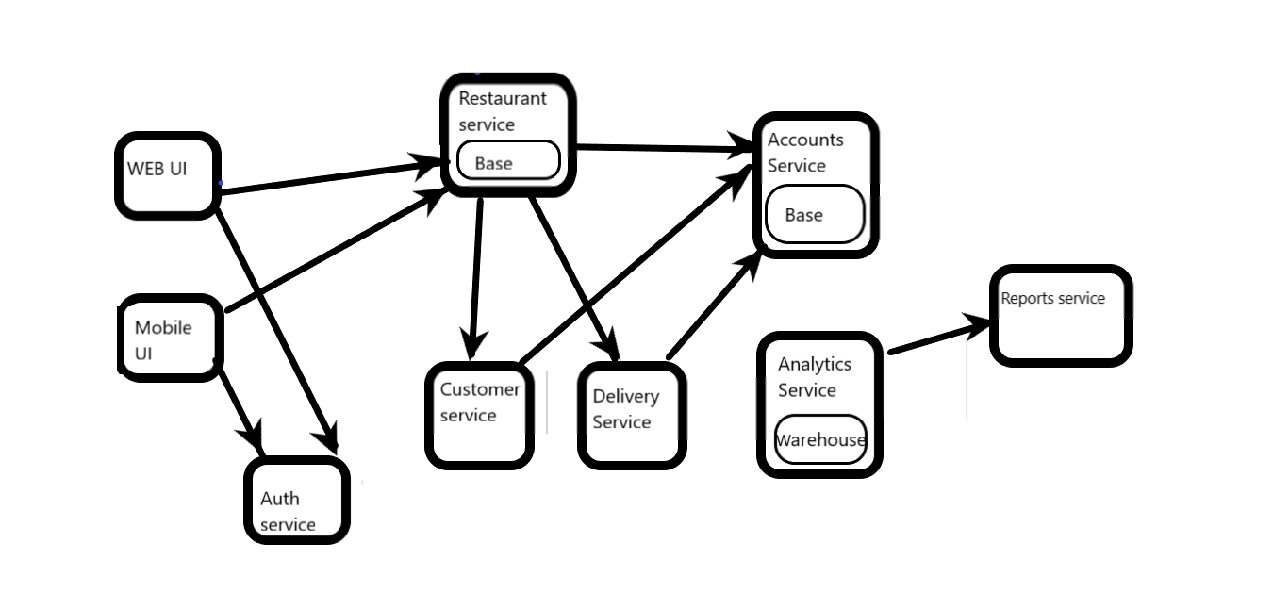
Design of microservices

Slide 11
Designing REST APIs
Service name | Collections | Methods
Search | Restaurants | Get List
Manage Restaurants | Restaurants | Add Modify
Orders Processing | Orders | Add get update
Accounts Service | Accounts | Add List Delete
Analytics | sales | Analyze Get list

Slide 12
Defining Storage Characteristics
Service | Structured or Unstructured | SQL or NoSQL | Strong or Eventual Consistency | Amount of Data (MB, GB, TB, PB, ExB) | Read only or Read/Write
Restaurants | Structured | NoSQL | Eventual | GB | Read/Write
Restaurants uploads | Unstructured | N/A | N/A | TB | Read/Write
Orders | Structured | SQL | Strong | TB | Read/Write
Accounts | Structured | SQL | Strong | GB | Read/Write
Analytics | Structured | SQL | Eventual | TB | Readonly

Slide 13
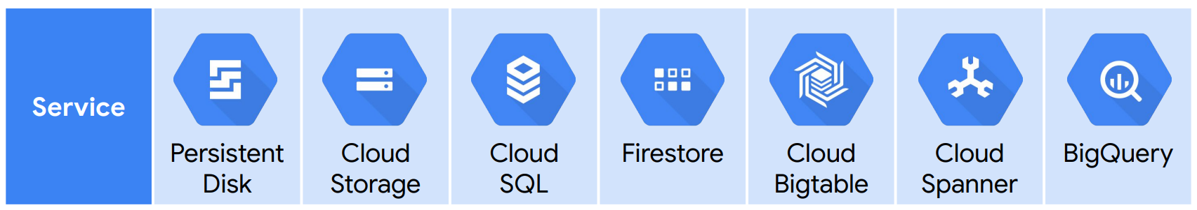
Choosing Google Cloud Storage and Data Services
Restaurants |  |  |  | X
Restaurants uploads |  | X
Orders |  |  | X
Accounts |  |  | X
Analytics |  |  |  |  |  |  | X

Slide 14
Defining Network Characteristics
Service | Internet facing or Internal only | HTTP | TCP | UDP | Multiregional?
Search | Internet facing | X |  |  | Yes
Web UI & mobile UI | Internet facing | X |  |  | Yes
Orders | Internal |  | X |  | No
Analytics | Internal | X |  |  | No
Authenticate | Internal |  | X |  | No

Slide 15
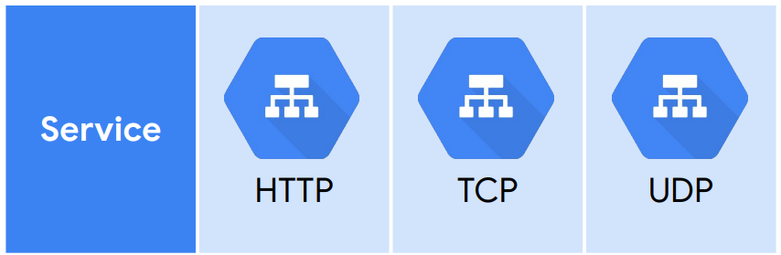
Selecting the Load Balancers
Search | X
Web UI & mobile UI | X
Orders |  | X
Analytics | X
Authenticate |  | X

Slide 16
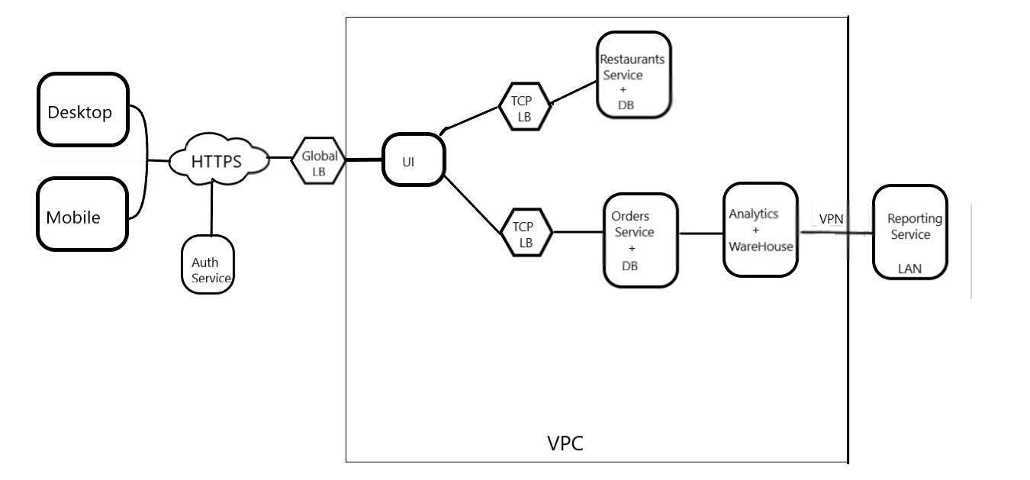
Diagramming of network

Slide 17
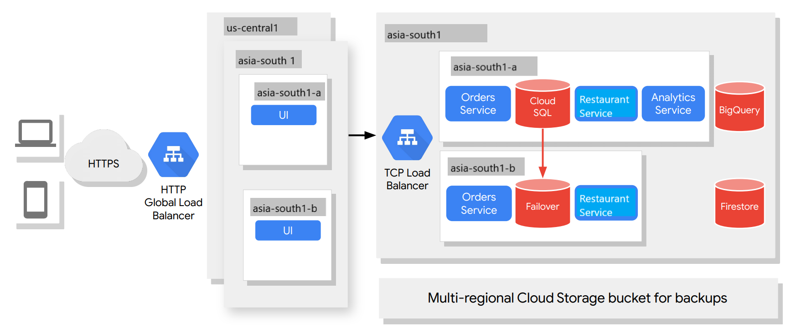
Design for Reliability and Scalability

Slide 18
Design for Reliability and Scalability(cont..)
We can also replicate backend to multiple regions in case of main region failure

Slide 19
Service Disaster Recovery Scenarios
Recovery point obj – amount of data acceptable to lose.
Recovery time obj - amount of time it can take to get back the data.
Service | Scenario | Recovery Point Objective | Recovery Time Objective | Priority
Restaurants | Accidental delete by programmer | zero | 1 min | High
Orders | crash of database that storing the undelivered orders | zero | 1-5 min | High
Accounts | Database failure | zero | 1 min | Med
Analytics | User deletes table | 1 hour | 24 hours | Med

Slide 20
Resource Disaster Recovery Plans
Resource | Backup Strategy | Backup Location | Recovery Procedure
Restaurants Firestore | Daily automated backups | Multi-regional cloud Storage bucket | Cloud functions and cloud scheduler
Orders cloud SQL database | Failover replica in another zone | Another cloud SQL DB | Failover run backup script
Accounts | Failover replica in another zone | Another cloud SQL DB | Failover run backup script
Analytics big-query database | NA | NA | Re-import data to rebuild analytics tables

Slide 21
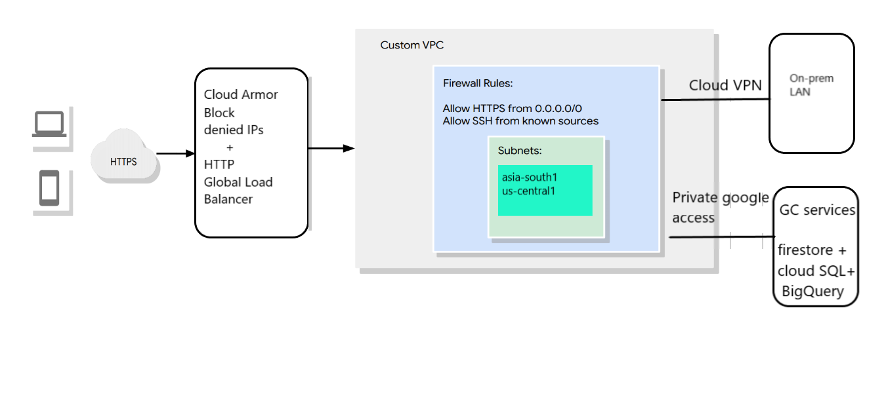
Modeling Secure Google Cloud Services

Slide 22
Cost estimating and planning(very rough) (at one lakh restaurants with 10 million users)
Service Name | Google Cloud Resource | Cost per month
Orders | Cloud SQL | $ 1178.2
Restaurants | Firestore | $ 215.41
Restaurants uploads | Cloud Storage | $ 230.00
Analytics | Bigquery | $ 214.72

